Slide 1
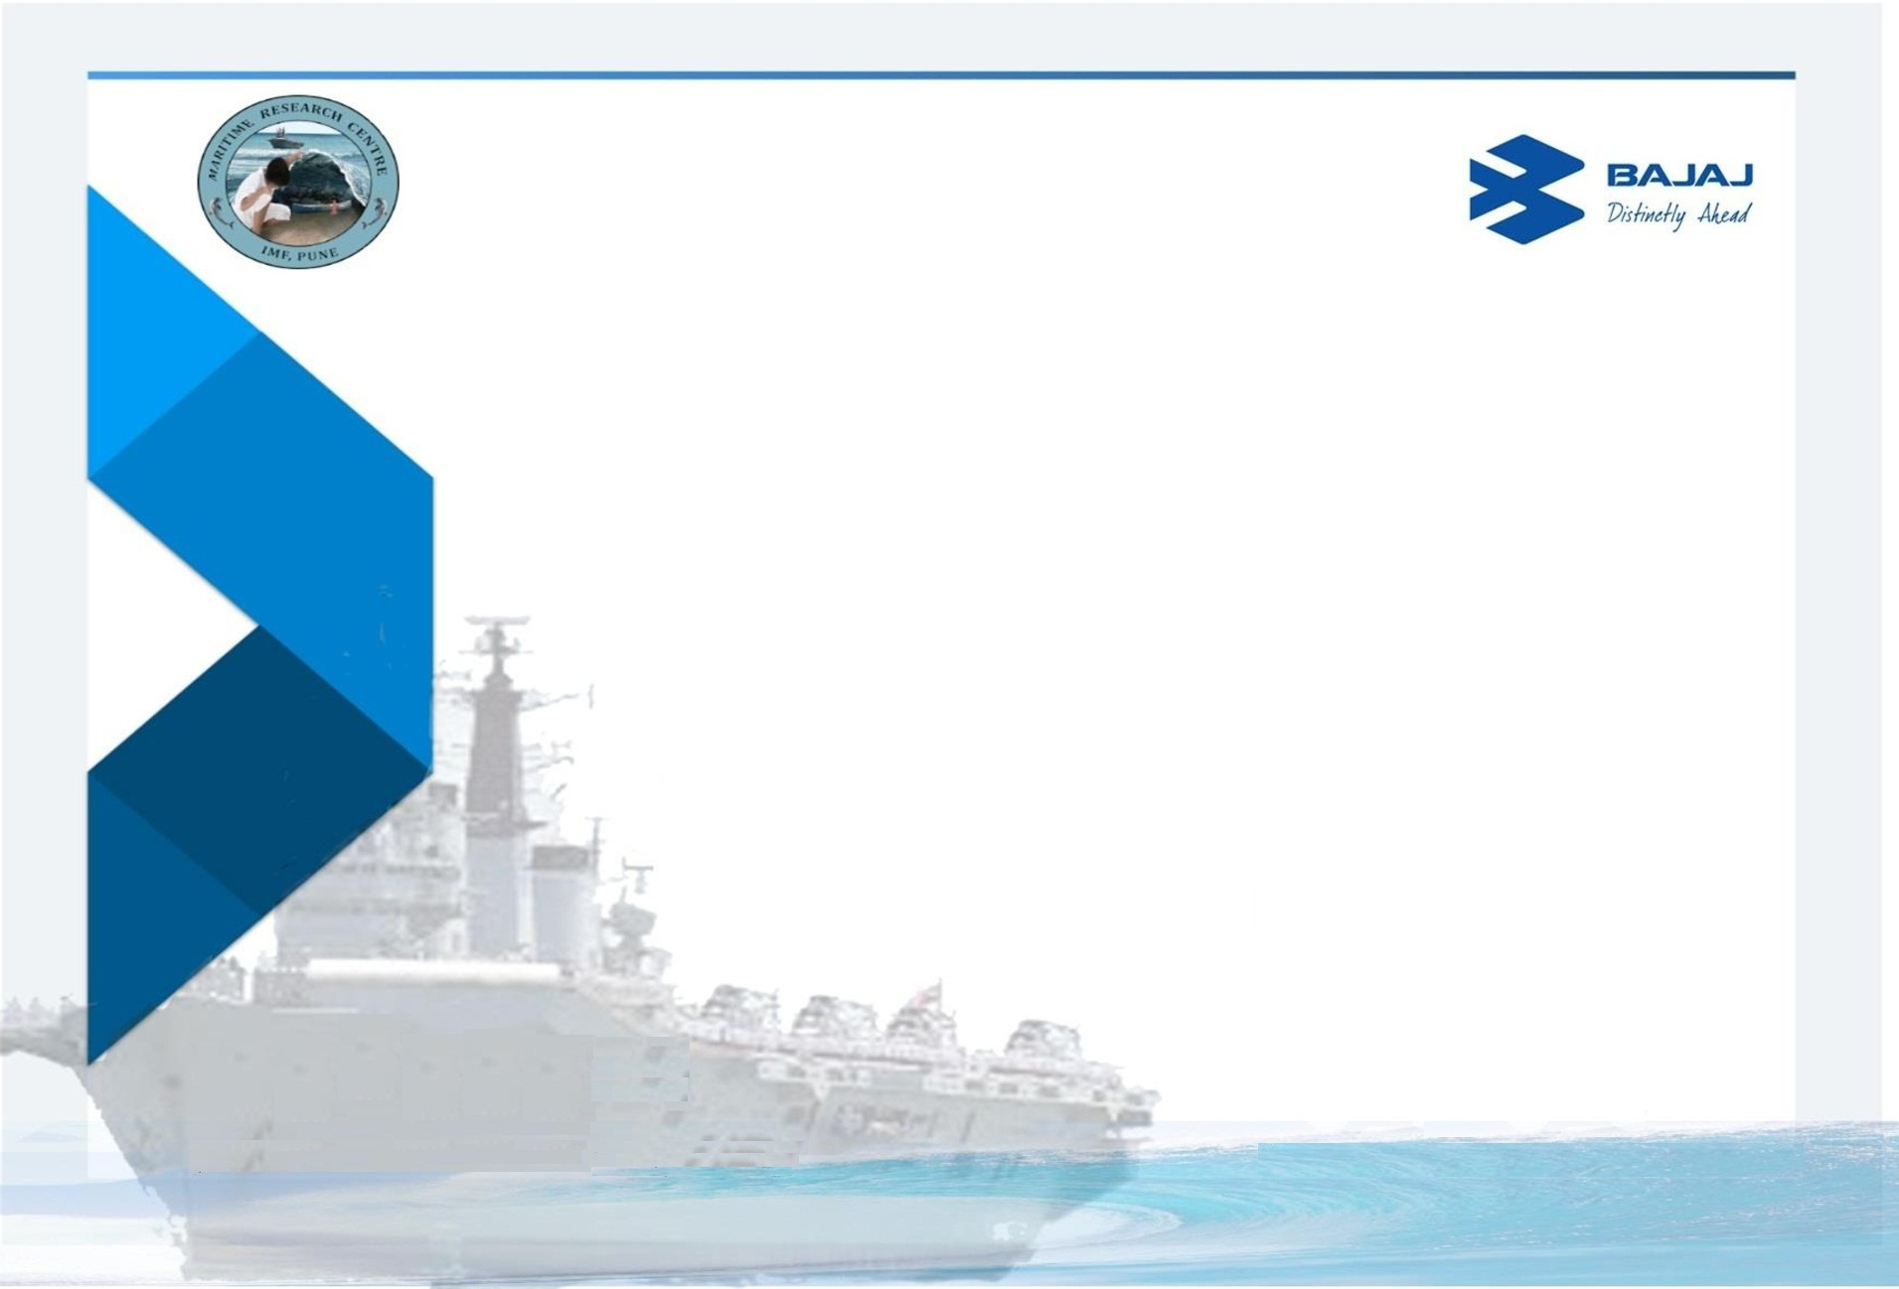


Workshop on
Sediment Classification and Field Experiment
9th – 13th October 2017
Dr.(Cdr) Arnab Das
Director, Maritime Research Centre, Pune.

Slide 2
Objective of workshop
Multi-disciplinary and Multi-activity approach for research based Real World problem solving.
Comprehensive technology approach to Underwater Domain Awareness.
Innovative Water Resource Management Initiative.
Addressing the Challenges of UDA in the Tropical Regions.

Slide 3
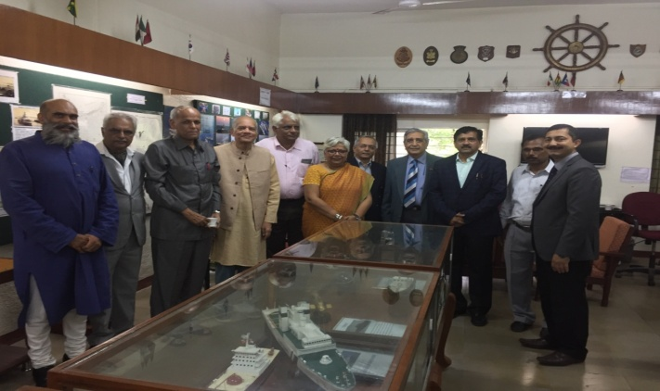
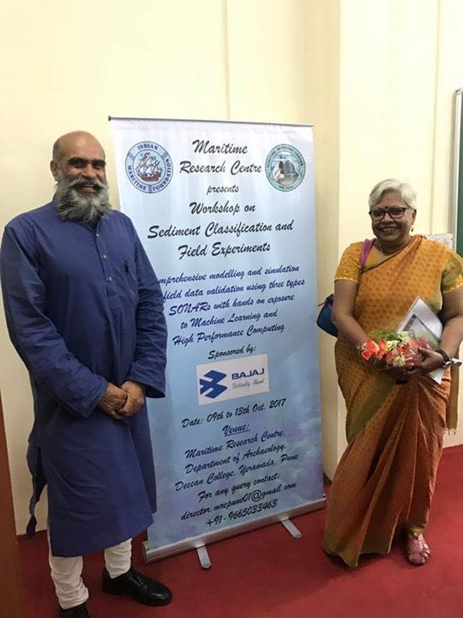
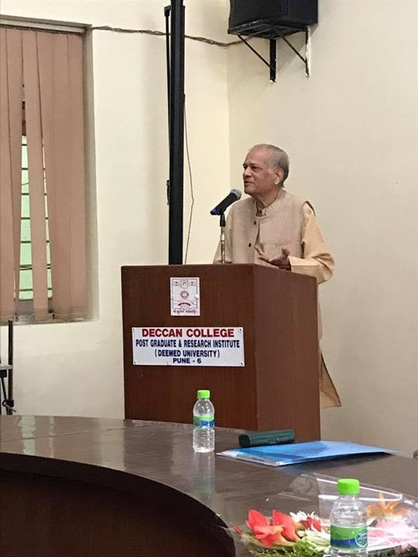
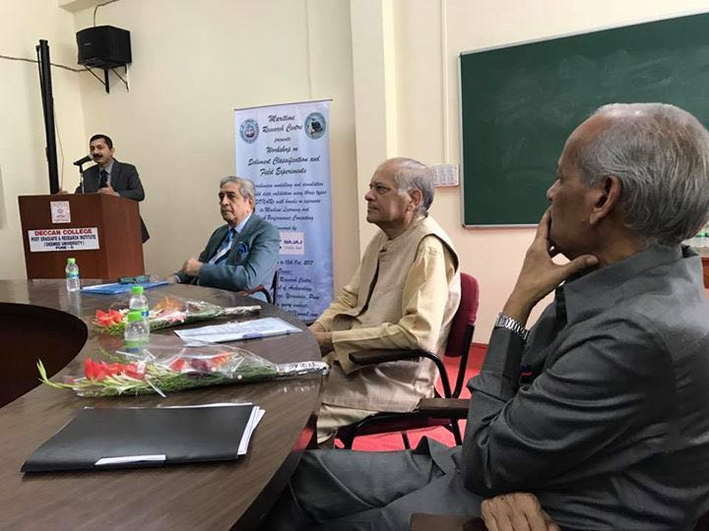
Day 1 : Inaugural Event & Panel Discussion
Welcome address by Cmde Rajan Vir (Retd)

Slide 4
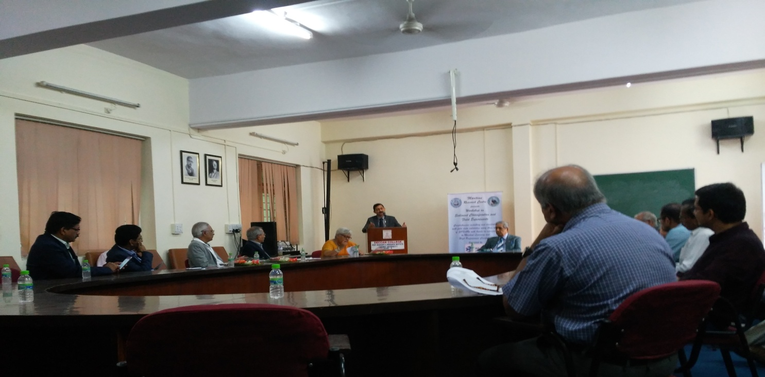
Day 1 : Introduction to UDA and Acoustics in Tropical Waters
Opening Address by Dr. (Cdr) Arnab Das.

Slide 5
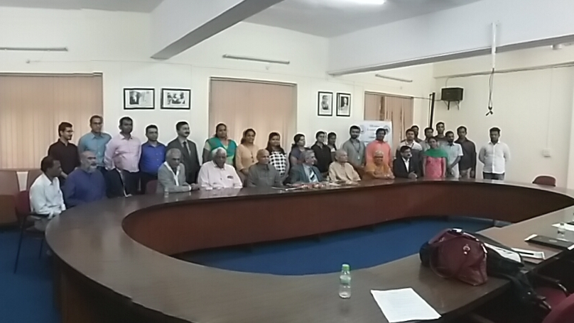
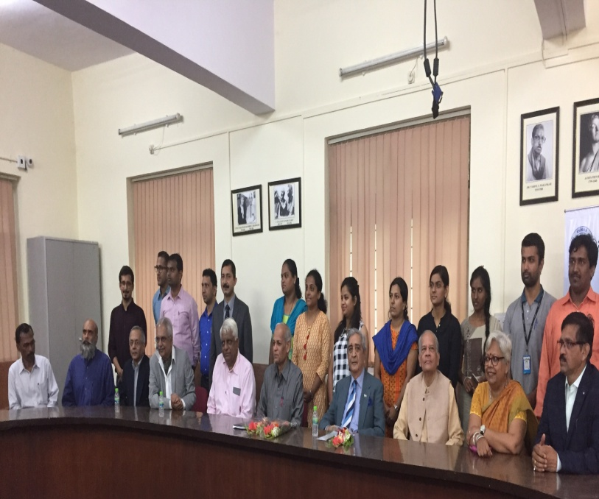
Day 1 : Introduction to UDA and Acoustics in Tropical Waters
Good Participation from over 14 institutes (7 locations)

Slide 6
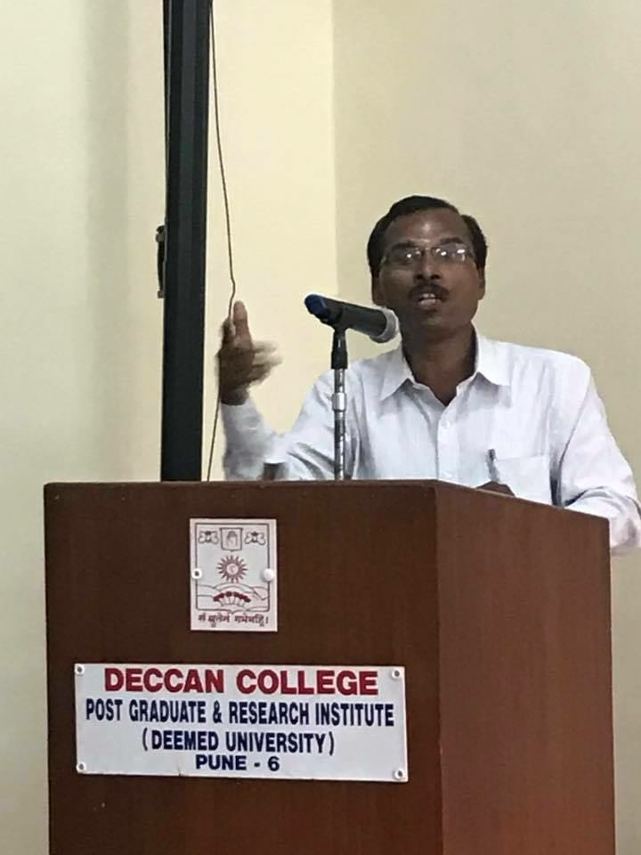
Day 1 : Introduction to UDA and Acoustics in Tropical Waters
Sediment Analysis – Marine Archaeologist Perspective by Prof. P. D. Sabale

Slide 7
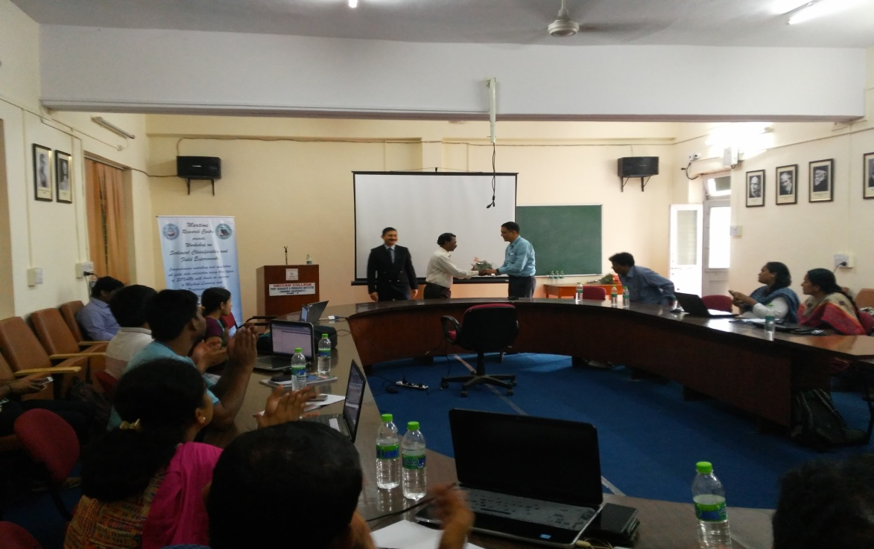
Day 2 : Modeling & Simulation
Prof PSV Natraj, IIT Mumbai

Slide 8
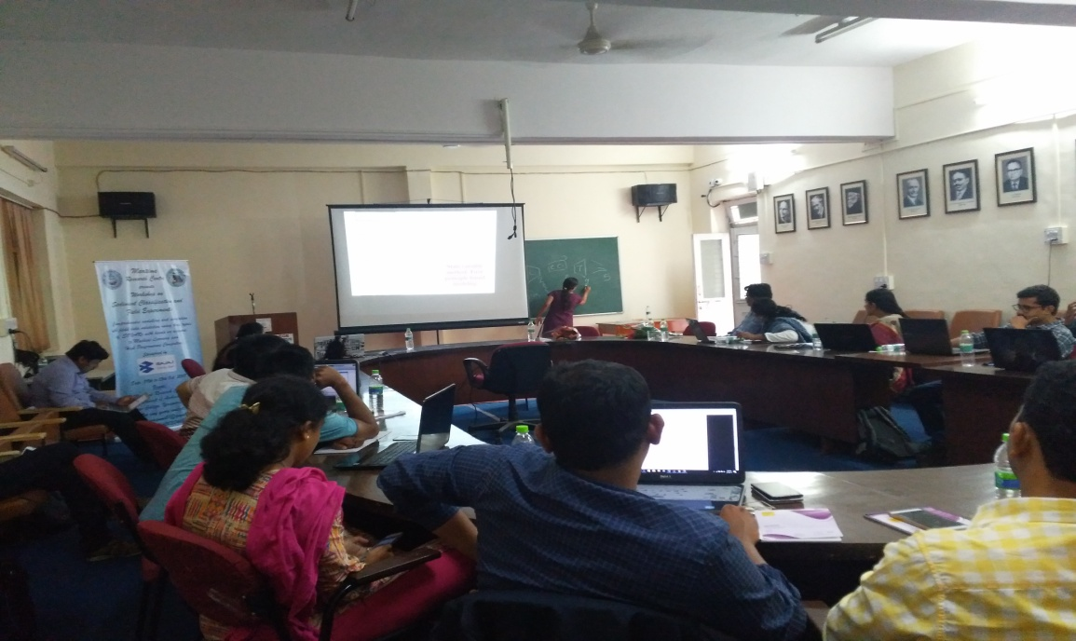
Day-2 : Analysis Tools
Case Studies by Bhagyashri and Rucha from IITB

Slide 9
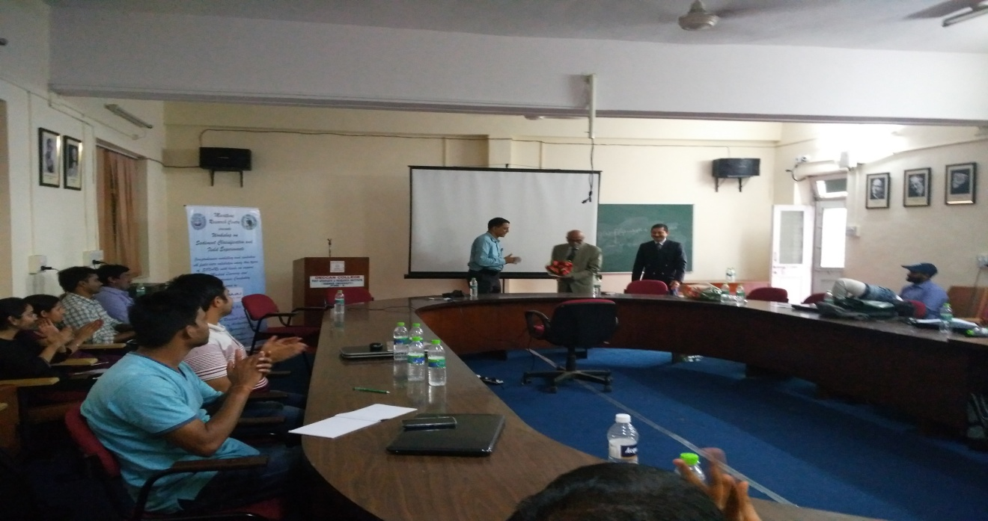
Day-2 : Analysis Tools
Address by Vice Admiral DSP Varma (Retd).

Slide 10
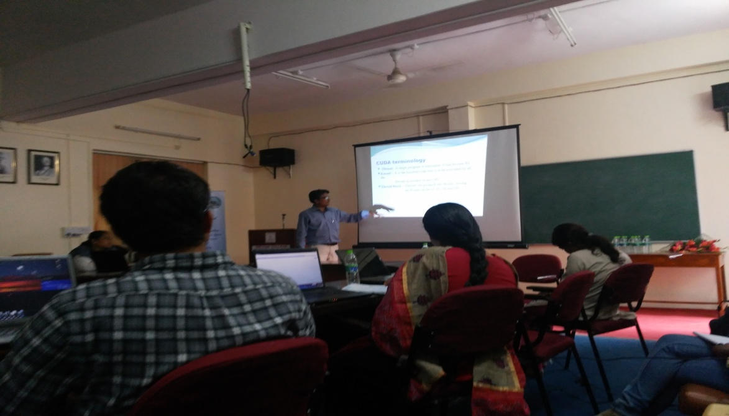
Day-2 : Analysis Tools
High Performance Computing and its Hands on session - Prof. Priyadarshan Dhabe

Slide 11
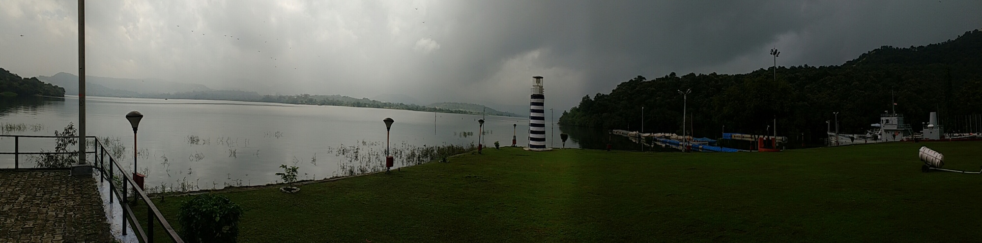
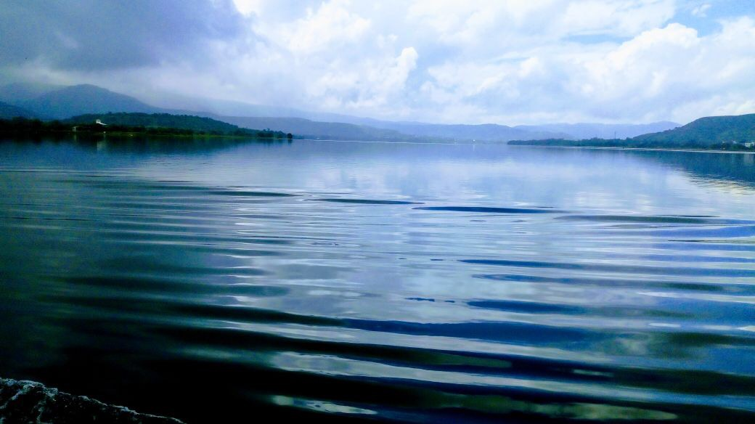
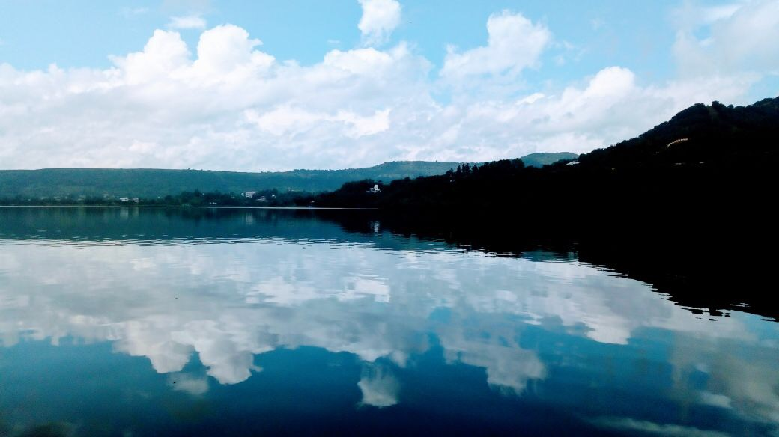
Experiment Site

Slide 12
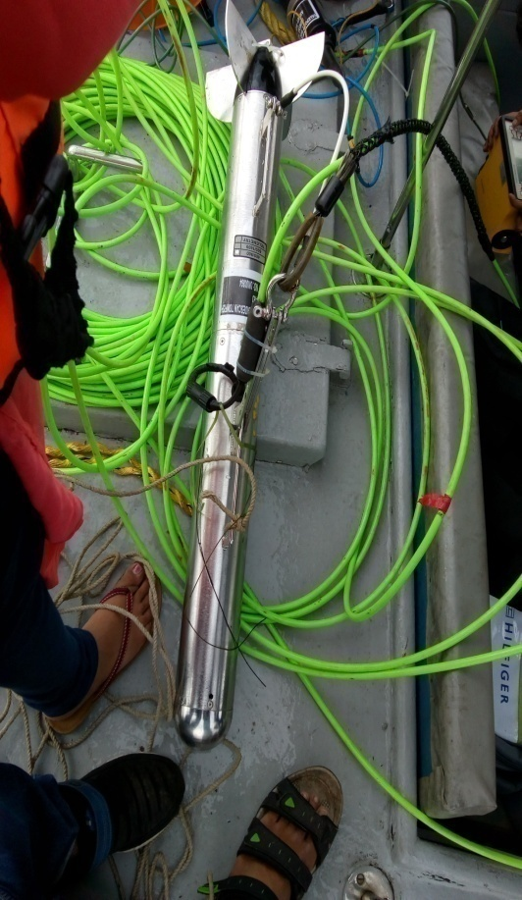
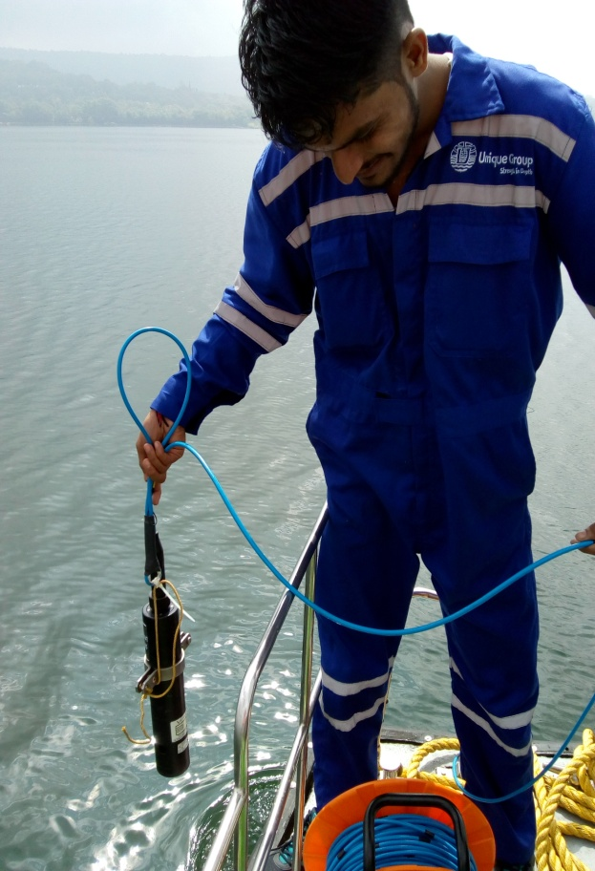
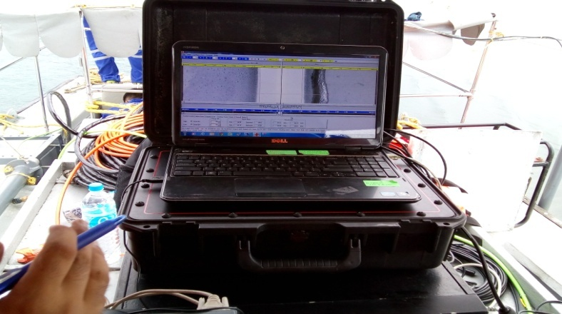
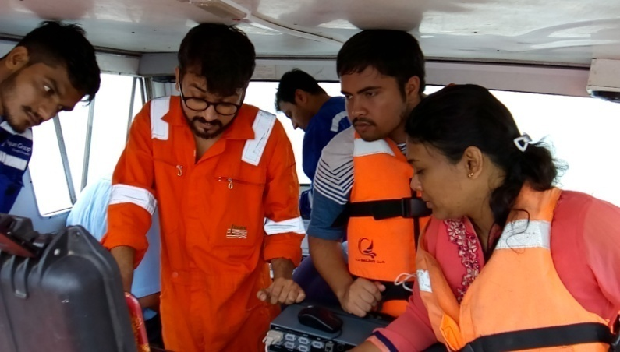
Experimental setup and team

Slide 13
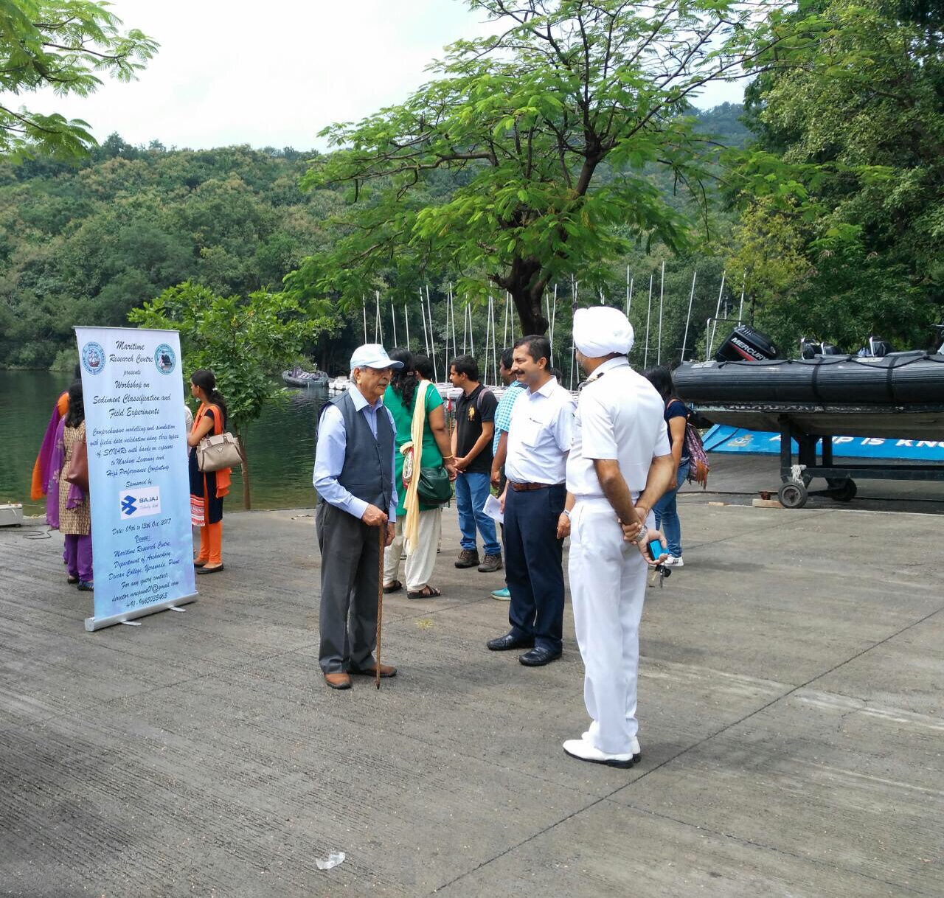
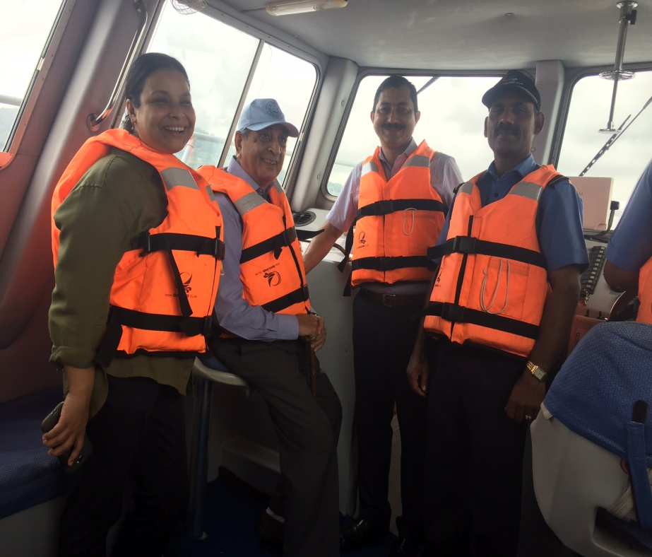
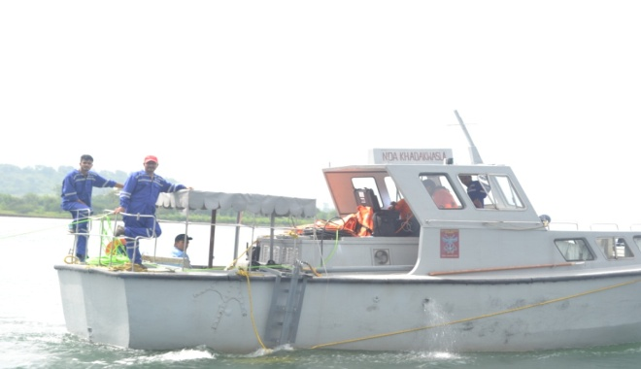
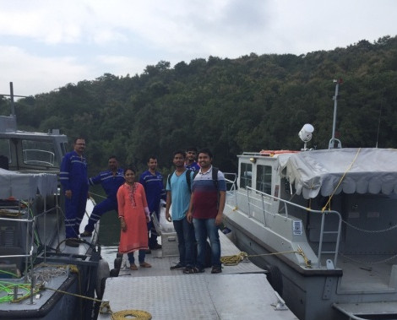
Day – 3 : Field Trials
Field Experimentation at Khadakwasla Lake

Slide 14
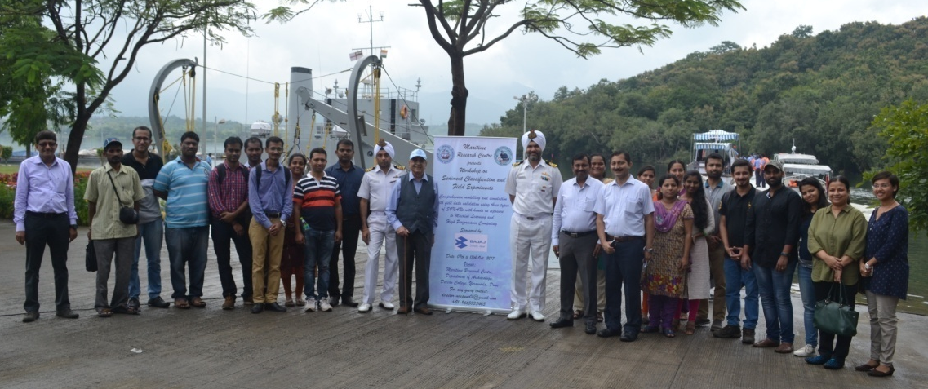
Day – 3 : Field Trials

Slide 15
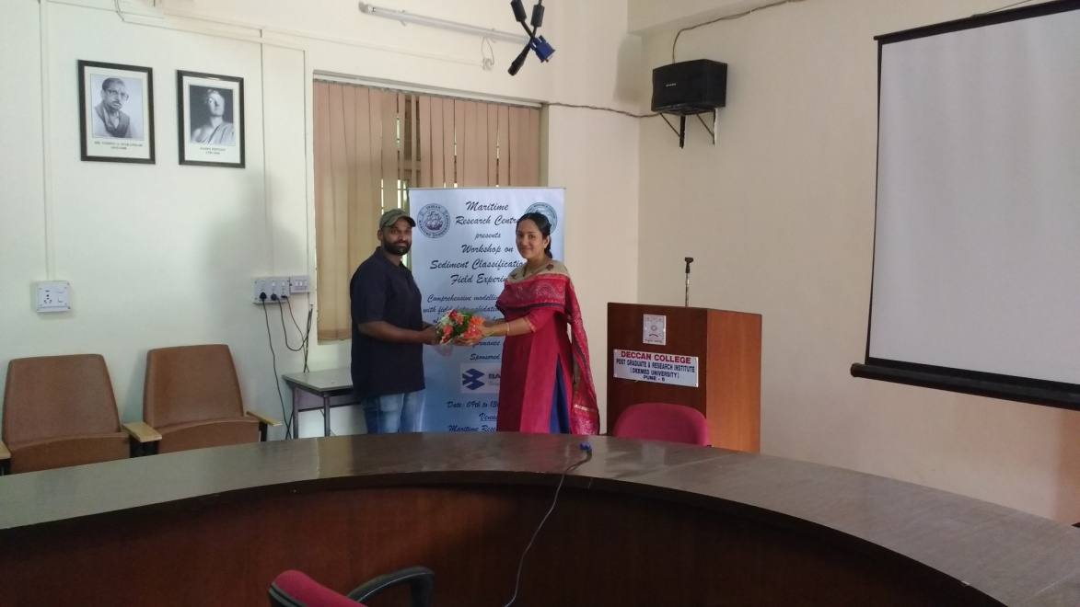
Day – 4 :Data Analysis and Coring
Deep Learning State-of-the-art and applications – Mr. Umesh Gupta

Slide 16
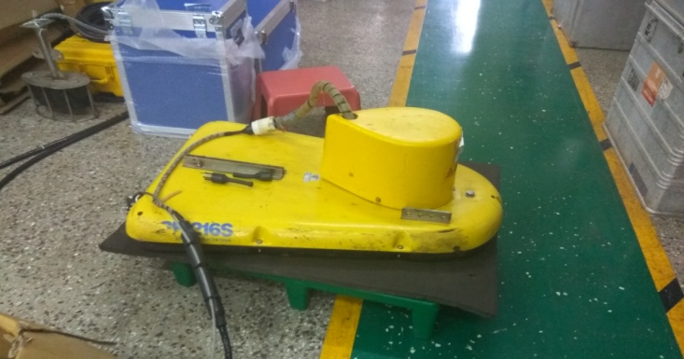
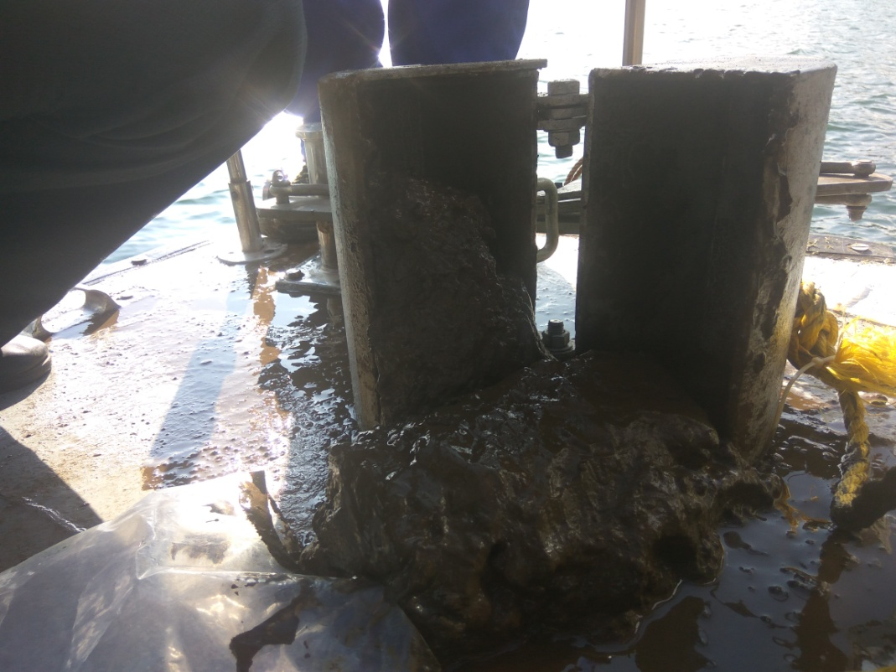
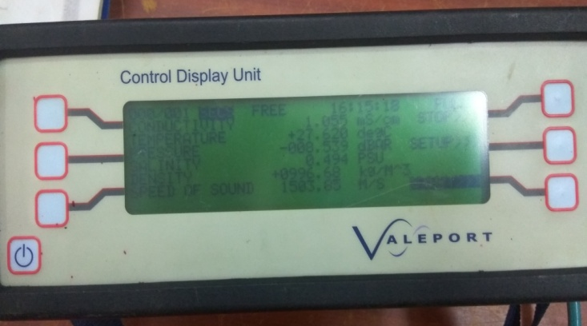
Day – 4 :Data Analysis and Coring
Field work on coring and sample collection.

Slide 17
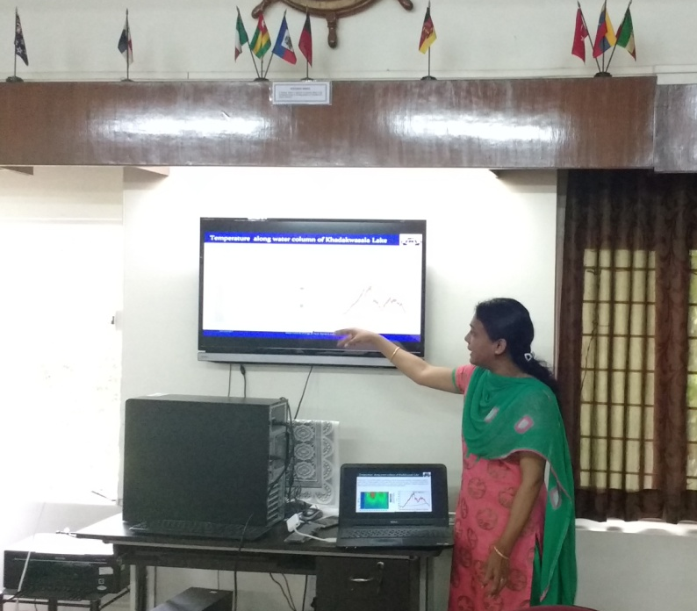
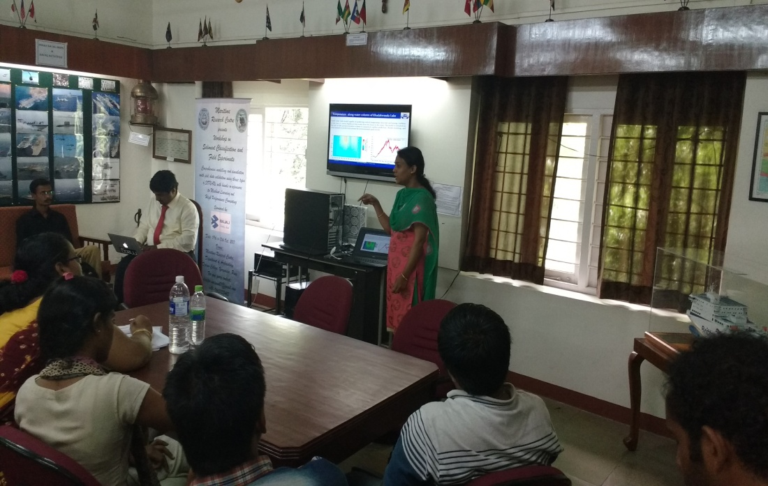
Day–5 : Conclusion
Research Perspective on Sediment Classification – Mrs. Jyoti Sadalge

Slide 18
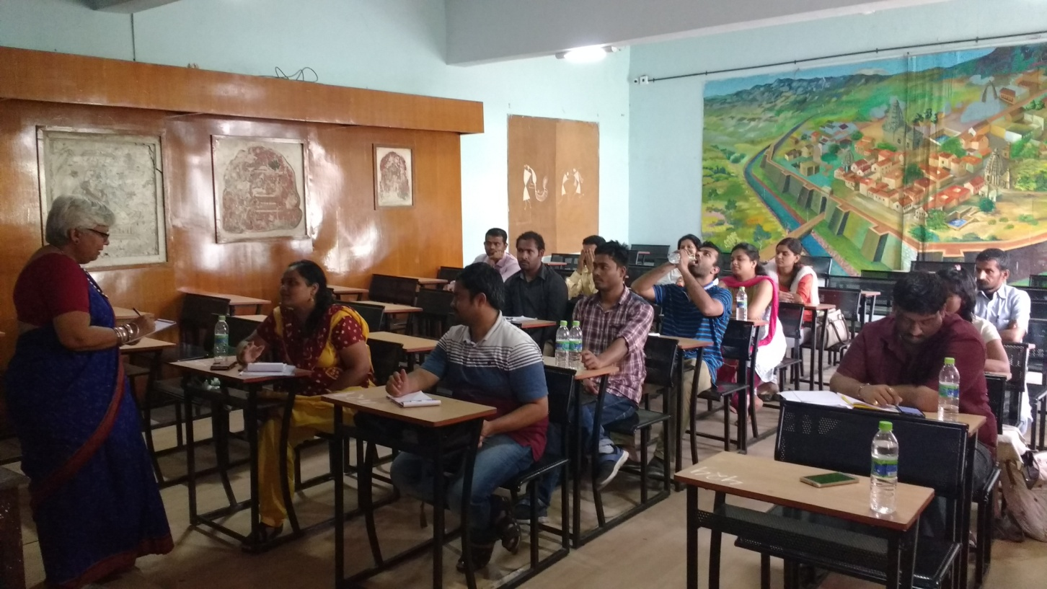
Day–5 : Conclusion
Feedback session

Slide 19
Thank You

